Slide 1
Tuples

Slide 2
Tuples
A tuple is a collection of different data types which is ordered and unchangeable (immutable). Tuples are written with round brackets, (). Once a tuple is created, we cannot change its values. We cannot use add, insert, remove methods in a tuple because it is not modifiable (mutable). Unlike list, tuple has few methods. Methods related to tuples:
tuple(): to create an empty tuple
count(): to count the number of a specified item in a tuple
index(): to find the index of a specified item in a tuple
operator: to join two or more tuples and to create a new tuple

Slide 3
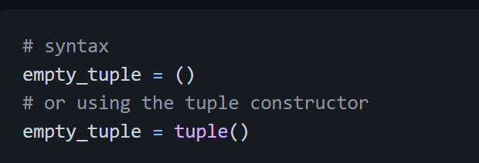
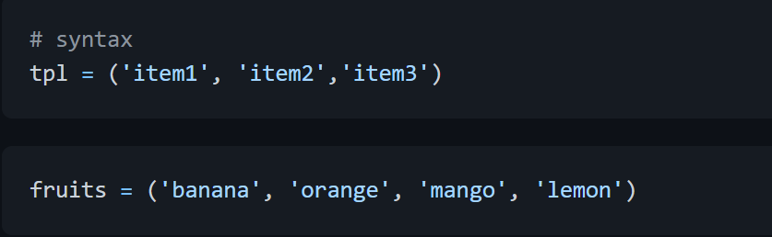
Creating a Tuple
Empty tuple: Creating an empty tuple
Tuple with initial values

Slide 4
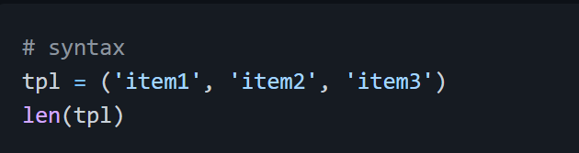
Tuple length
We use the len() method to get the length of a tuple.

Slide 5
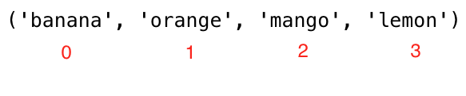
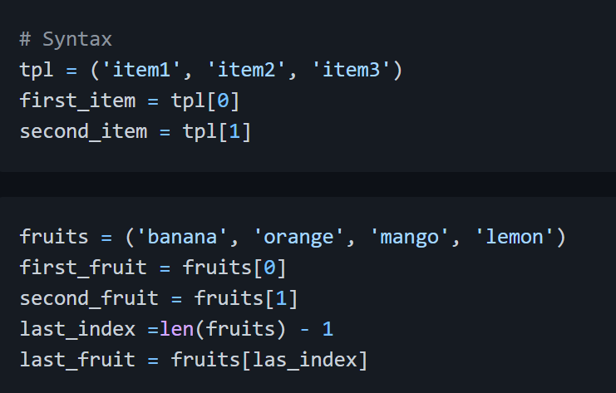
Accessing Tuple Items
Positive Indexing Similar to the list data type we use positive or negative indexing to access tuple items.

Slide 6

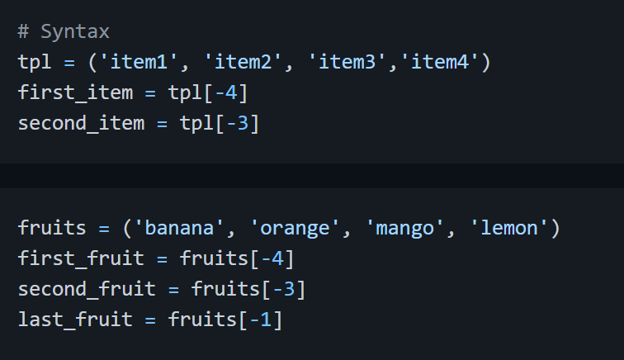
Negative indexing Negative indexing means beginning from the end, -1 refers to the last item, -2 refers to the second last and the negative of the list/tuple length refers to the first item.

Slide 7
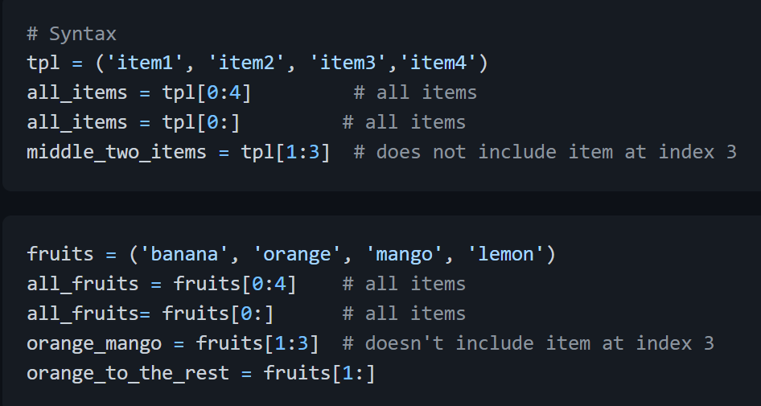
Slicing tuples
We can slice out a sub-tuple by specifying a range of indexes where to start and where to end in the tuple, the return value will be a new tuple with the specified items.
Range of Positive Indexes

Slide 8
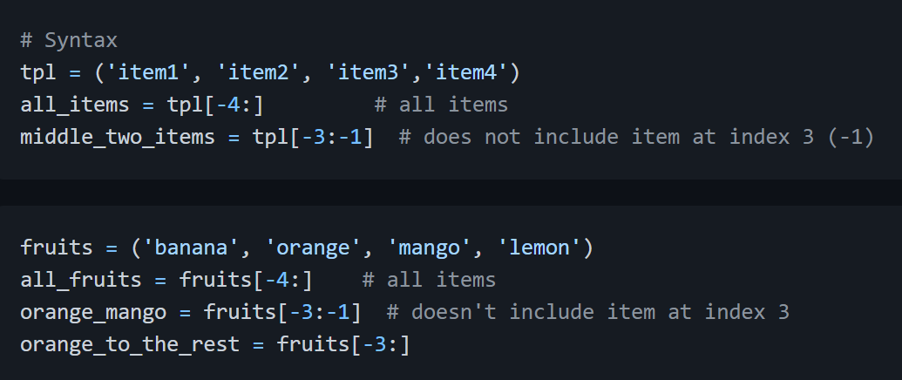
Range of Negative Indexes

Slide 9
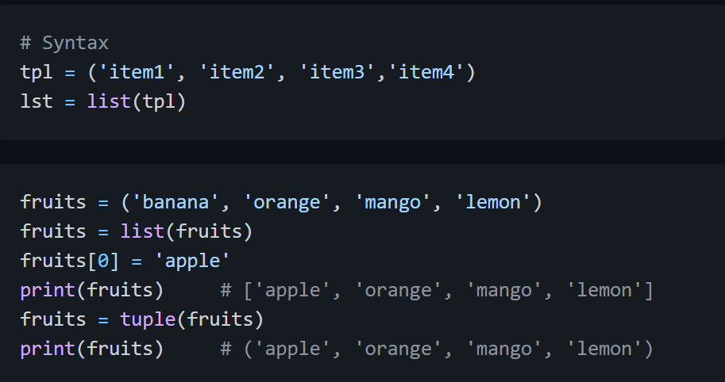
Changing Tuples to Lists
We can change tuples to lists and lists to tuples. Tuple is immutable if we want to modify a tuple we should change it to a list.

Slide 10
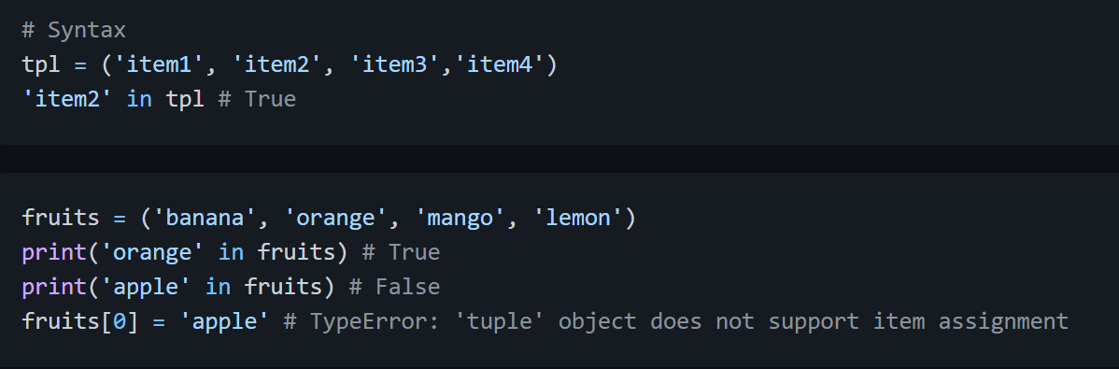
Checking an Item in a Tuple
We can check if an item exists or not in a tuple using in, it returns a boolean.

Slide 11
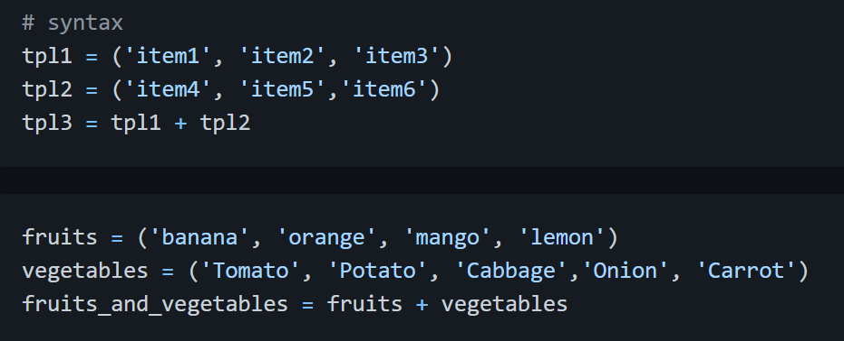
Joining Tuples
We can join two or more tuples using + operator

Slide 12
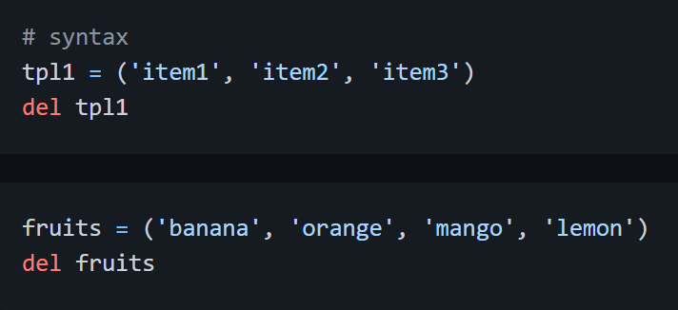
Deleting Tuples
It is not possible to remove a single item in a tuple but it is possible to delete the tuple itself using del.

Slide 13
Exercises: Level 1
Create an empty tuple
Create a tuple containing names of your sisters and your brothers (imaginary siblings are fine)
Join brothers and sisters tuples and assign it to siblings
How many siblings do you have?
Modify the siblings tuple and add the name of your father and mother and assign it to family_members

Slide 14
Exercises: Level 2
Unpack siblings and parents from family_members
Create fruits, vegetables and animal products tuples. Join the three tuples and assign it to a variable called food_stuff_tp.
Change the about food_stuff_tp tuple to a food_stuff_lt list
Slice out the middle item or items from the food_stuff_tp tuple or food_stuff_lt list.
Slice out the first three items and the last three items from food_staff_lt list
Delete the food_staff_tp tuple completely

Slide 15
Check if an item exists in tuple:
Check if 'Estonia' is a nordic country
Check if 'Iceland' is a nordic country

